Slide 1
Firefly (Deta)

Slide 2
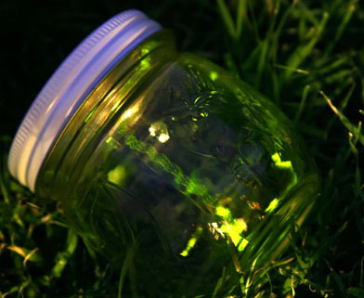
Fire - fly, fire - fly in the night. With a yel - low, with a yel - low,
with a yel - low light. How I like to watch you shine to - night.

Slide 3
De - ta de - ta tsu - ki - ga. Ma - ru - i, Ma - ru - i
ma - n - ma - ru - i. O - bo - n - o yo - na tsu - ki - ga.

Slide 4
Let's add some ostinatos!

